Slide 1
Capsule Networks: Capturing Presence and Orientation of Representations
JD Doak, 5853
Joshua Coon, 5448
Rolando Fernandez, 5448
Mark T. Louie, 5548
Theo Stangebye, 5448
Notes:
I’m not sure I like the title, in particular the use of the term “survey” and “architecture”. There are only 3 seminal papers on capsule networks so far, to the best of my knowledge, so it’s hardly a survey. Also, “architecture” refers to only one part of capsule networks.
SAND2018-8239 C

Slide 2
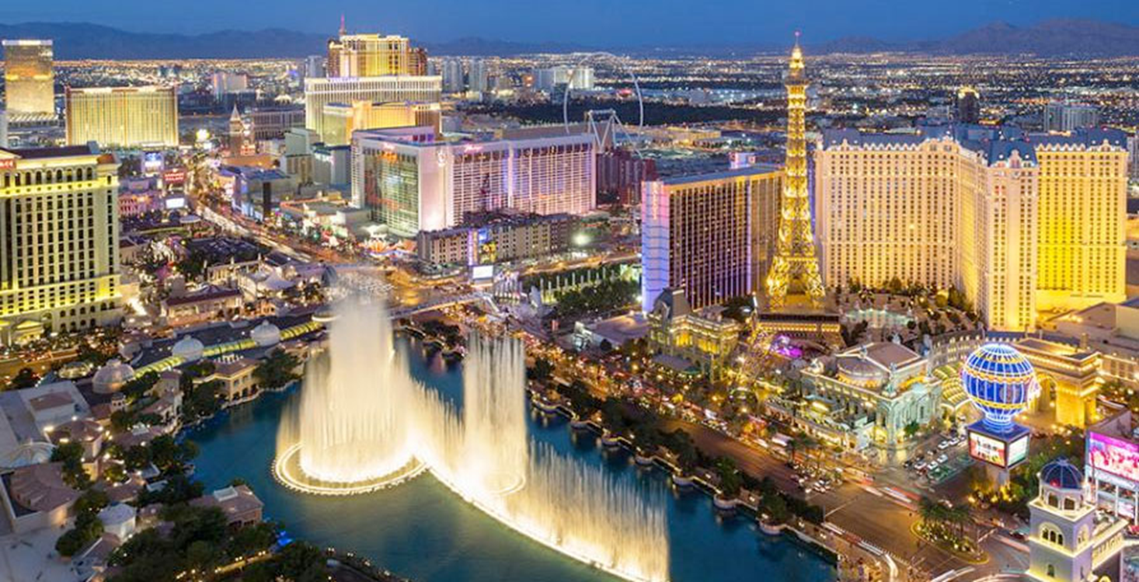
Notes:
I presented “Tracking Cyber Adversaries with Adaptive Indicators of Compromise” at Computational Science Computational Intelligence in December of 2017 in Las Vegas.
After my talk, Gerald Penn from the Computer Science Department at the University of Toronto came up and told me he enjoyed me talk.
He told me that Geoffrey Hinton works in the same department as he does and that he’d come out with a new type of network called a capsule network.

Slide 3
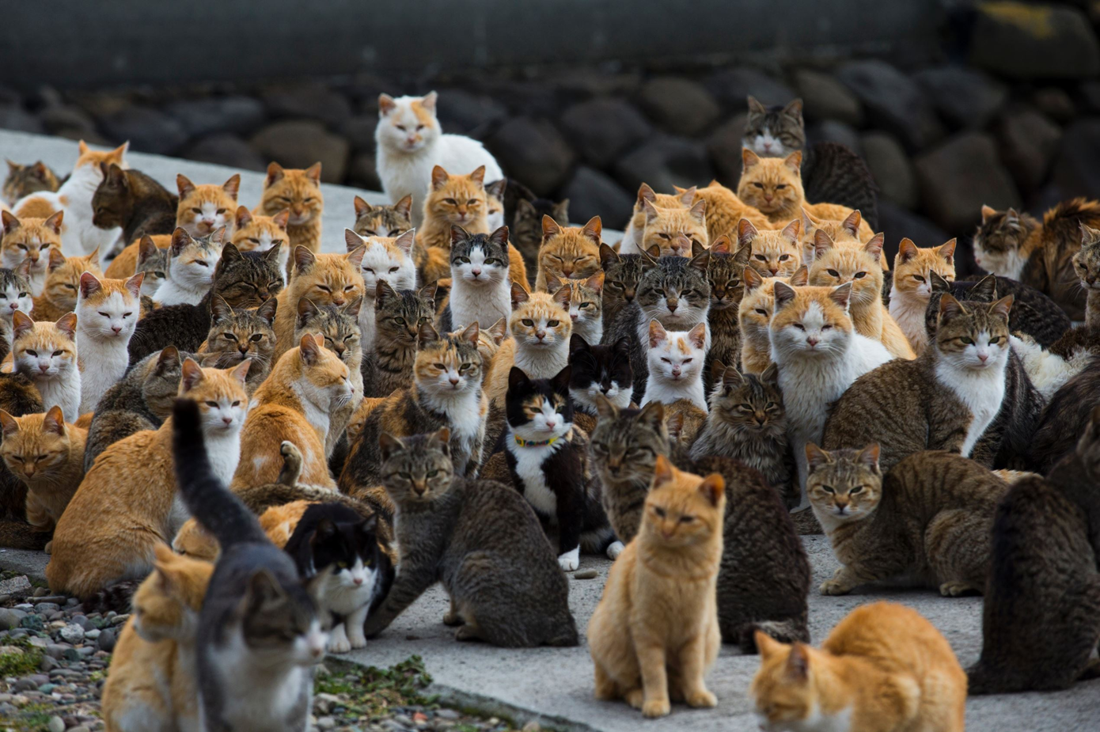
Notes:
A group of cats is called a Clowder.
A capsule is a group of neurons.
The output is a vector, not a scalar, which contains spatial information, i.e., pose.

Slide 4
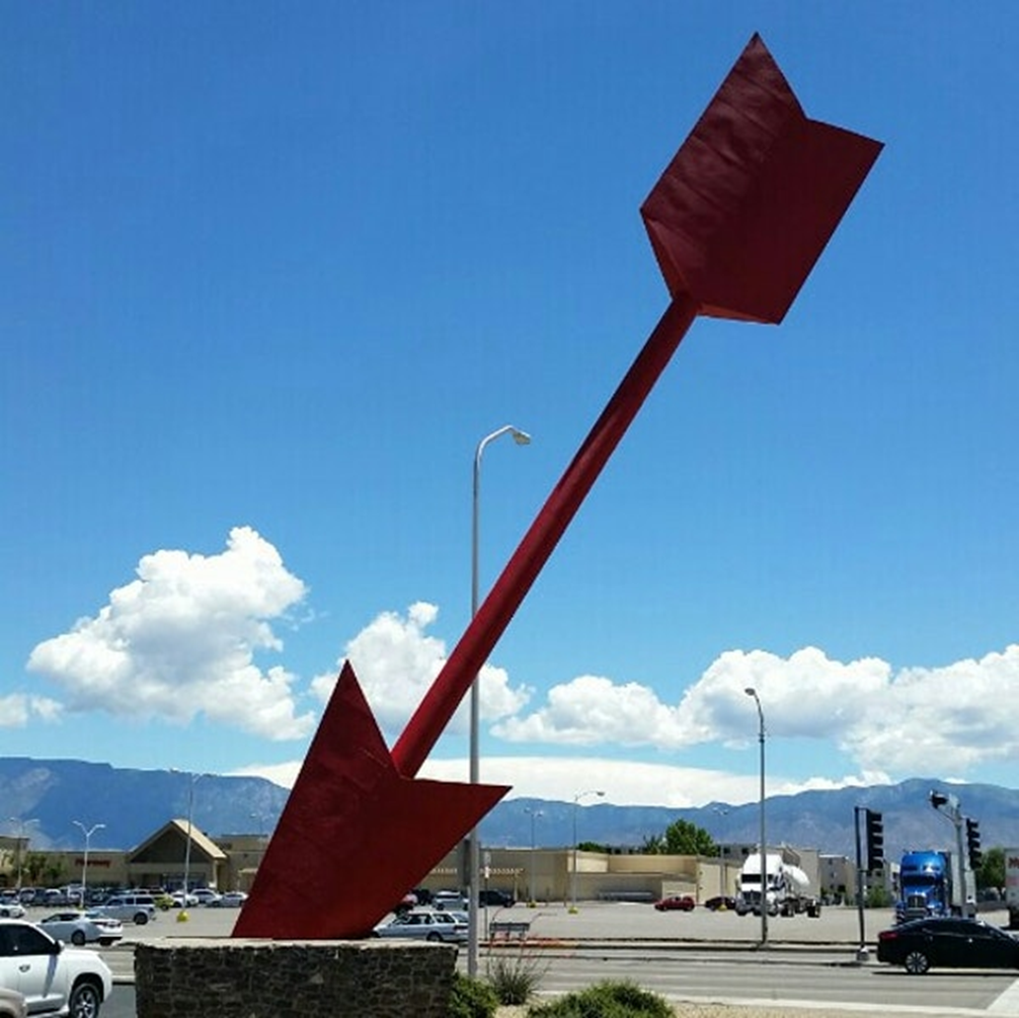
Notes:
Vector: the length of the line shows its magnitude and the arrowhead points in the direction.
Also “Matrix Capsules with EM Routing” paper: 4x4 + 1 neurons – pose + activation

Slide 5
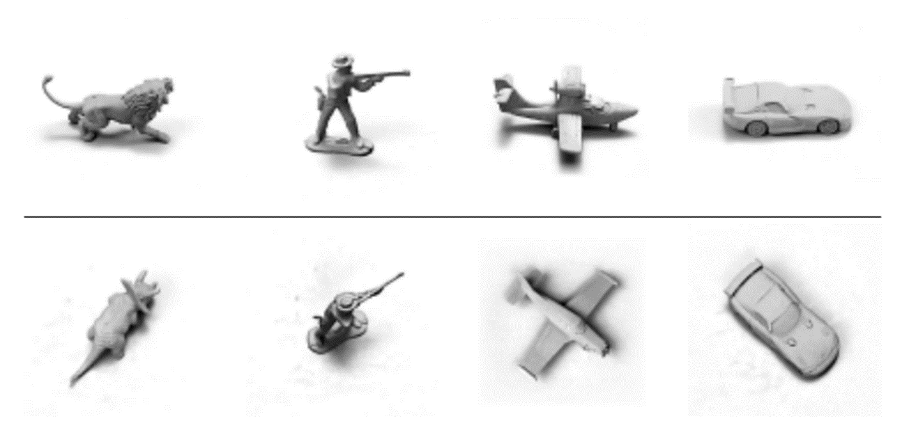
Notes:
A capnet can correctly identify objects irrespective of view angle.
That is, how it represents objects, like the brain, does not depend on view angle.
The network stores a representation of the pose of the object.
Improves error by 45% relative to current approaches.
Geron indicated that it did better with overlapping digits in MNIST than current approaches.

Slide 6
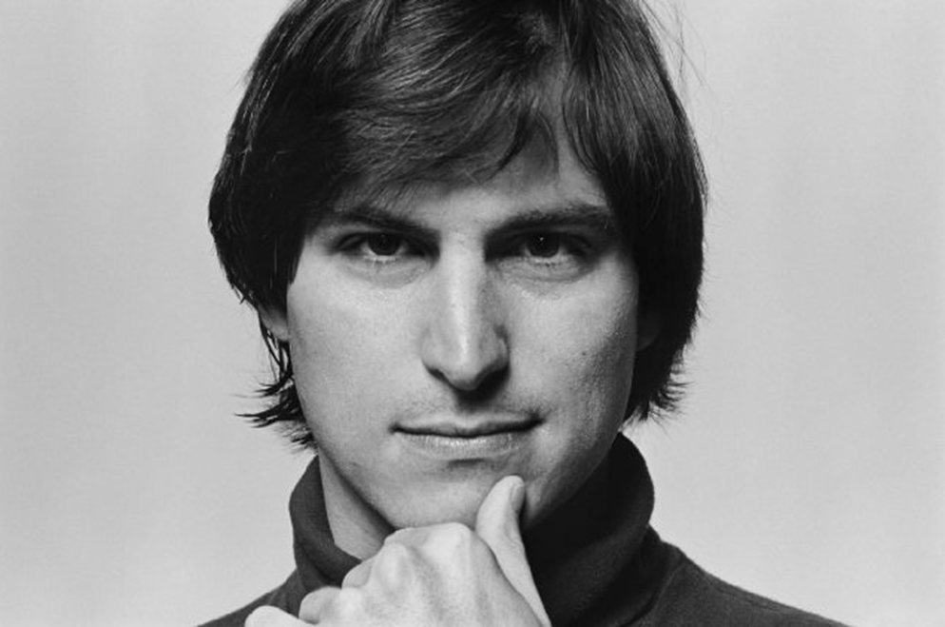
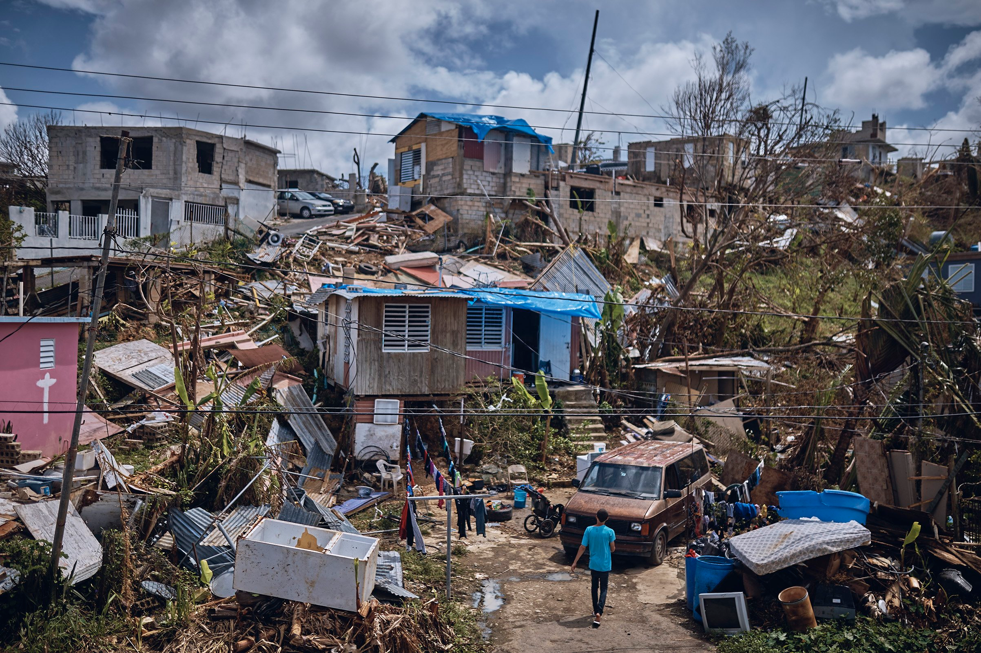
Notes:
Hinton originally published his capsule idea in 2011 in Transforming Auto-Encoders. (Steve Jobs died in 2011.)
Dynamic Routing between Capsules in 2017 describes an algorithm for training a capnet. (We had a humdinger of a hurricane season in 2017. This is a picture of the devastation in Puerto Rico caused by Hurricane Maria.)
In the neuron case, weights are learned during backpropagation. In the case of the capsule, they are determined using “dynamic routing”, which is a novel way to determine where each capsule’s output goes.
They created an iterative routing-by-agreement mechanism: A lower-level capsule prefers to send its output to higher level capsules whose activity vectors have a big scalar product with the prediction coming from the lower-level capsule.
Also “Matrix Capsules with EM Routing” paper: 4x4 + 1 neurons – pose + activation

Slide 7
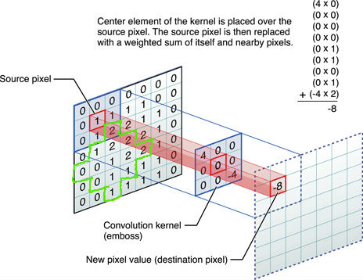
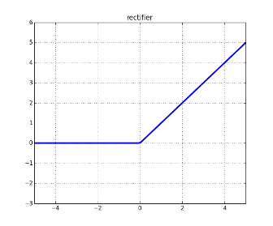
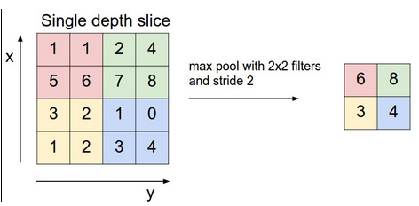
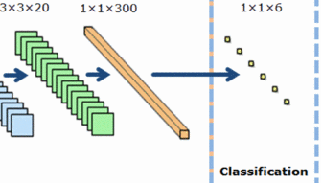

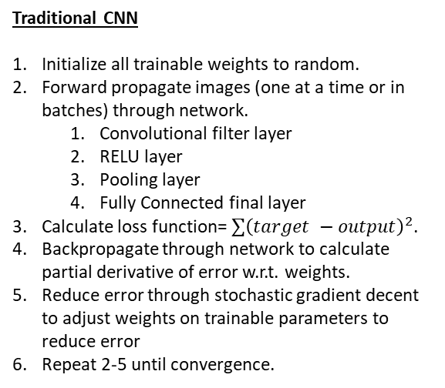
Comparison of Traditional CNNs to CapNets
Convolutional Layer
RELU Layer
Traditional CNN
Initialize all trainable weights to random.
Forward propagate images (one at a time or in batches) through network.
Convolutional filter layer
RELU layer
Pooling layer
Fully Connected final layer
Calculate loss function= $∑{\left(target −output\right)}^{2}$.
Backpropagate through network to calculate partial derivative of error w.r.t. weights.
Reduce error through stochastic gradient decent to adjust weights on trainable parameters to reduce error
Repeat 2-5 until convergence.
Max Pooling Layer
Fully Connected Layer
Combination = Convolutional Neural Network
Notes:
https://stats.stackexchange.com/questions/235032/any-use-of-non-rectangular-shaped-kernels-in-convolutional-neural-networks-espe
https://www.kdnuggets.com/2016/11/intuitive-explanation-convolutional-neural-networks.html/3
https://datascience.stackexchange.com/questions/5706/what-is-the-dying-relu-problem-in-neural-networks
http://cs231n.github.io/convolutional-networks/
http://pubs.sciepub.com/ajme/2/7/9/

Slide 8
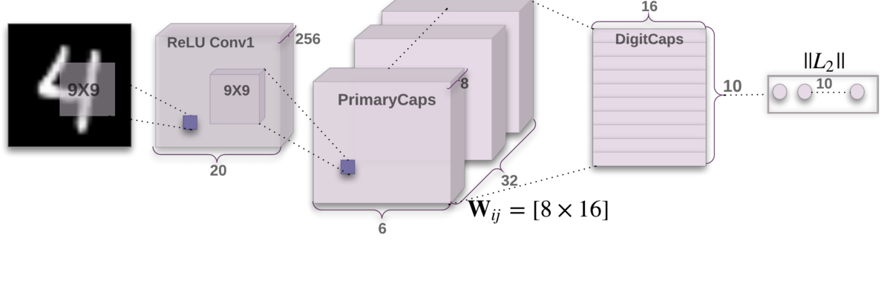
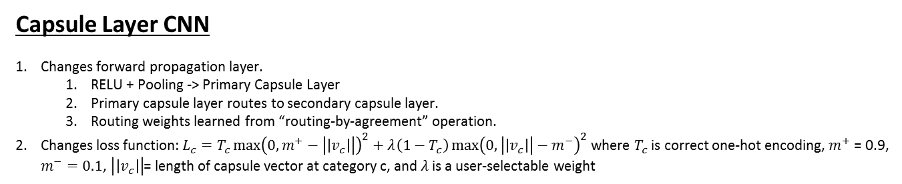
Comparison of Traditional CNNs to CapNets (Cont.)
Capsule Network
Capsule Layer CNN
Changes forward propagation layer.
RELU + Pooling -> Primary Capsule Layer
Primary capsule layer routes to secondary capsule layer.
Routing weights learned from “routing-by-agreement” operation.
Changes loss function: $L_{c}=T_{c}{\max\left(0, m^{+}−\left|\left|v_{c}\right|\right|\right)}^{2}+λ\left(1−T_{c}\right){\max\left(0,\left|\left|v_{c}\right|\right|−m^{−}\right)}^{2}$ where $T_{c}$ is correct one-hot encoding, $m^{+}$ = 0.9, $m^{−}=0.1$, $\left|\left|v_{c}\right|\right|$= length of capsule vector at category c, and $λ$ is a user-selectable weight
Notes:
https://stats.stackexchange.com/questions/235032/any-use-of-non-rectangular-shaped-kernels-in-convolutional-neural-networks-espe
https://www.kdnuggets.com/2016/11/intuitive-explanation-convolutional-neural-networks.html/3
https://datascience.stackexchange.com/questions/5706/what-is-the-dying-relu-problem-in-neural-networks
http://cs231n.github.io/convolutional-networks/
http://pubs.sciepub.com/ajme/2/7/9/
https://openreview.net/pdf?id=HJWLfGWRb

Slide 9
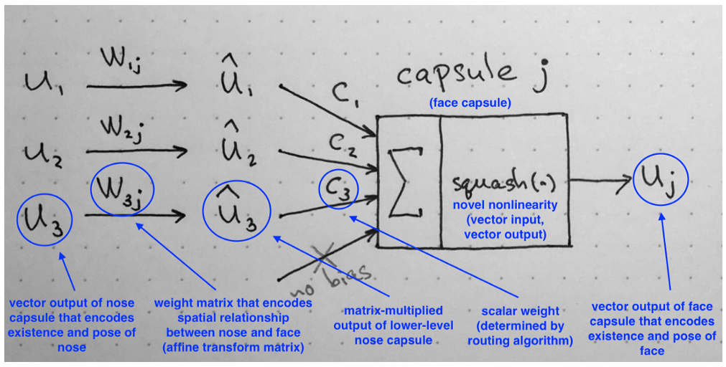
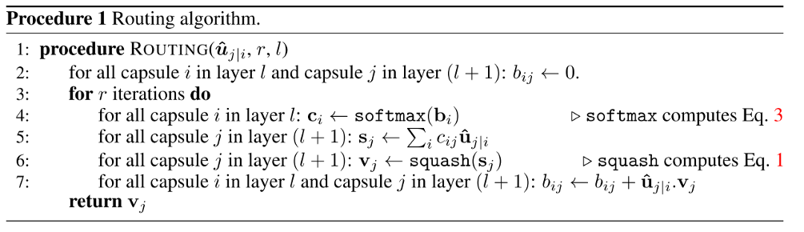
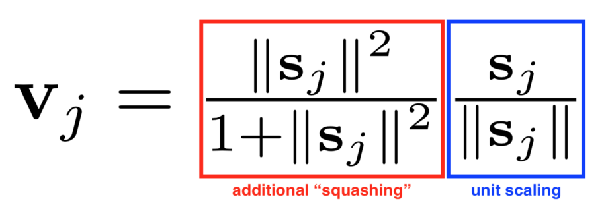
Routing By Agreement
Notes:
Overview of capsule networks
Occurs during forward pass through network
Show how implemented on MNIST network
MNIST is database of ~50,000 hand written digits that are 28x28
Not as complicated as it seems
“Squash” function

Slide 10
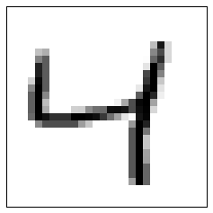
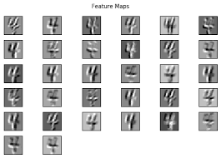
Capsule Network: MNIST Example
Input Layer
Convolutional Layer
28 x 28 Input
20 x 20 x 256 [height X width X filters]
9x9 kernel; stride 1; 256 filters
9x9x256 kernel, stride 2, 32 filters in 8 “capsules”
Primary Capsule Layer
6x6x32x8 [height X width X filters X capsules]
Vector Input to Routing
Secondary Capsule Layer(s)
Reshape (6x6x32)x8 = 1152 vectors with 8 dimensions
Routing by Agreement

Slide 11
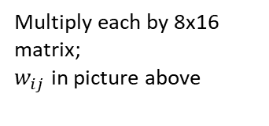
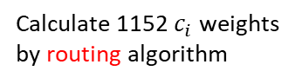
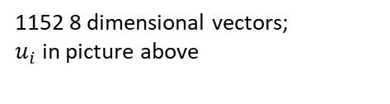
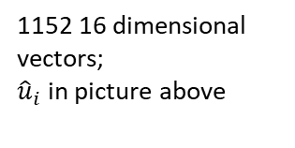
Routing by Agreement: MNIST Example
Loss function and categorical prediction
Output: 10 16 dimensional vectors (one vector for each digit)
1152 16 dimensional vectors;
${\hat{u}}_{i}$ in picture above
1152 8 dimensional vectors;
$u_{i}$ in picture above
…
Multiply each by 8x16 matrix;
$w_{ij}$ in picture above
…
…
Calculate 1152 $c_{i}$weights by routing algorithm

Slide 12
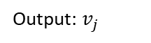
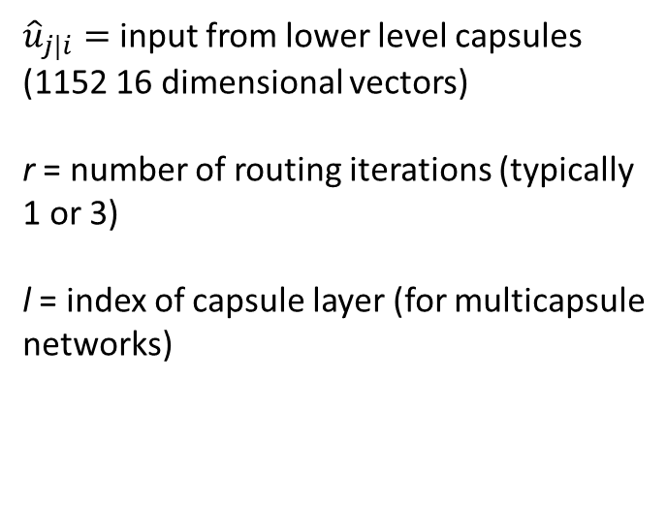
Routing Algorithm: MNIST Example
${\hat{u}}_{j|i}=$input from lower level capsules (1152 16 dimensional vectors)
r = number of routing iterations (typically 1 or 3)
l = index of capsule layer (for multicapsule networks)
Softmax:
$$c_{i} = \frac{\exp\left(b^{j}\right)}{\sum_{k=1}^{K}{exp⁡(b^{k})}}$$
Softmax:
𝑐_𝑖 = exp⁡(𝑏^𝑗 )/(∑24_(𝑘=1)^𝐾▒〖exp⁡(𝑏^𝑘)〗)
Calculate:
$$s_{j}=\sum_{i}{c_{ij}{\hat{u}}_{\left(j | i\right)}}$$
Calculate:
𝑠_𝑗=∑8_𝑖▒〖𝑐_𝑖𝑗 𝑢 ̂_(𝑗│𝑖) 〗
Squash:
$$v_{j}=\frac{{\left\|s_{j}\right\|}^{2}}{1+{\left\|s_{j}\right\|}^{2}}\frac{s_{j}}{\left\|s_{j}\right\|}$$
Squash:
𝑣_𝑗=‖𝑠_𝑗 ‖^2/(1+‖𝑠_𝑗 ‖^2 ) 𝑠_𝑗/‖𝑠_𝑗 ‖
Dot Product:
$${\hat{u}}_{j|i} ∙v_{j}=\left|\hat{u_{j}}\right||v_{j}|cosθ$$
Dot Product:
𝑢 ̂_(𝑗|𝑖) ∙𝑣_𝑗=|(𝑢_𝑗 ) ̂ ||𝑣_𝑗 |𝑐𝑜𝑠𝜃
Reinforce:
$$b_{ij}=b_{ij}+{\hat{u}}_{j|i}∙v_{j}$$
Reinforce:
𝑏_𝑖𝑗=𝑏_𝑖𝑗+𝑢 ̂_(𝑗|𝑖)∙𝑣_𝑗
Repeat r times
Output: $v_{j}$
Loss function and categorical prediction

Slide 13
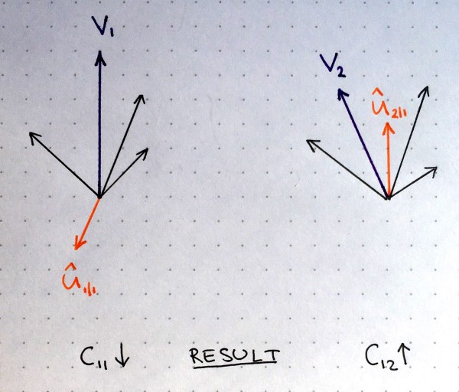
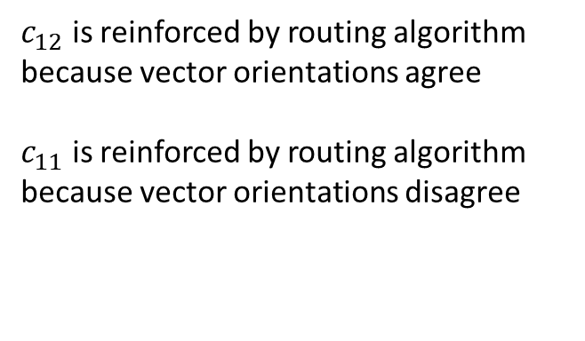
Routing Algorithm: Intuition
$c_{12}$ is reinforced by routing algorithm because vector orientations agree
$c_{11}$ is reinforced by routing algorithm because vector orientations disagree
Orange: Two inputs from lower level capsule
Purple: Output of two higher level capsules
Black: Remaining inputs from lower level capsules

Slide 14
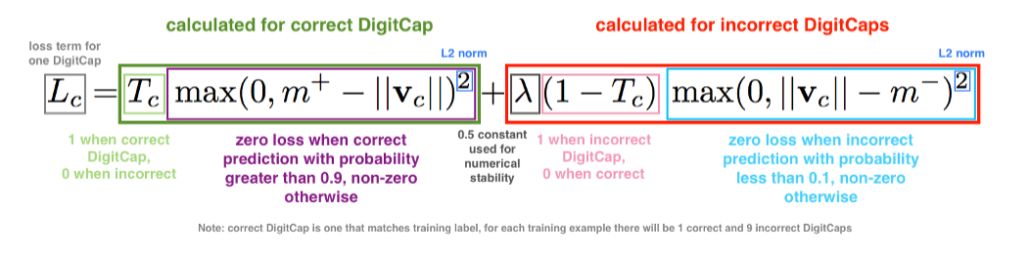
Loss Function
If the length of the vector in the correct capsule is > 0.9, loss is 0
If length of vector in the correct capsule is < 0.1, loss is 1

Slide 15
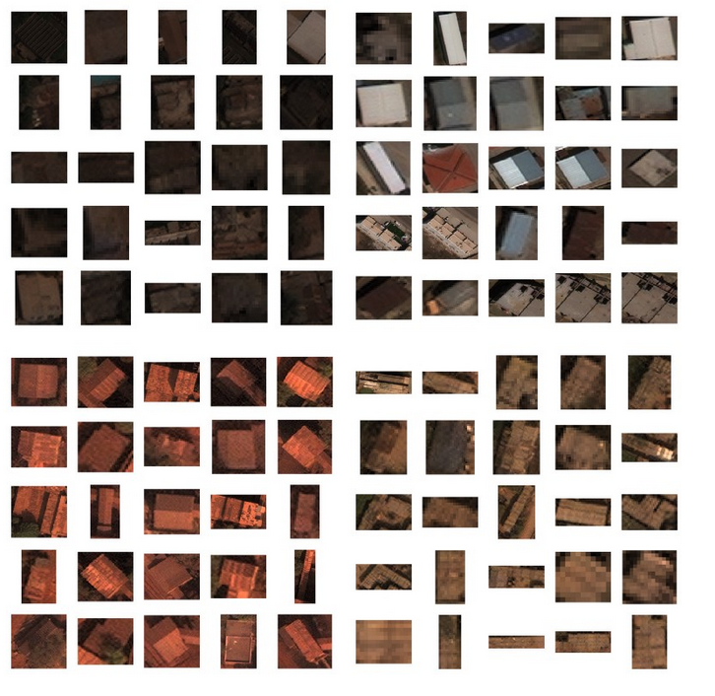
Description of the data used
Released to public from Defense Innovation Unit Experimental (DIUx) and National Geospatial-Intelligence Agency (NGA)
1 Million Object Instances
60 Classes
0.3 Meter Resolution
Images labelled by humans
Amazon Mechanical Turk, etc.
Notes:
http://xviewdataset.org/#dataset
https://medium.com/@dariusl/object-detection-baselines-in-overhead-imagery-with-diux-xview-c39b1852f24f

Slide 16
Results
5 vehicle class subset of full dataset, ~3000 images.
Crane truck, dump truck, bulldozer, excavator, cement mixer
Training overfits training dataset giving a high training accuracy, with 40% accuracy on withheld testing dataset.
25% average precision reported in XView paper
Not quite apples-to-apples
Doing SSD on 300x300 chips, not tight chips
Will examine dropout layers
Accuracy hampered by inaccurate labels in original dataset.
Student intern corrected labels
40% is still much better than chance
Summer intern working on library implementation of CapNets in Tensorflow with plans for a PyTorch version.

Slide 17
CapNets Resources
Web
Understanding Hinton’s Capsule Networks. Parts I – IV, medium.com
Capsule Networks Are Shaking up AI — Here’s How to Use Them, hackernoon.com
Papers
Transforming Auto-encoders
Dynamic Routing Between Capsules
Matrix Capsules with EM Routing
Mentions that capsules are resistant to white box adversarial attack.
Video
Capsule Networks, https://www.youtube.com/watch?v=pPN8d0E3900
Code
Tensorflow implementation: https://github.com/naturomics/CapsNet-Tensorflow
PyTorch implementation https://github.com/gram-ai/capsule-networks

Slide 19
Conclusions
Indicate at which session you’d like to present
Deep Learning Day
What is the one-sentence summary of your work that you would want a technical person to remember?
Capsule networks (CapNets) are an improvement on traditional convolutional neural networks because CapNets utilize information about the relative placement of objects in a scene and also pose information.
What is the one-sentence summary of your work that you would want a manager or program developer to remember?
Geoff Hinton developed an improvement to traditional convolutional neural networks called capsule networks and technical staff at Sandia understand both how they work and how to implement them.
Do you prefer an oral or a poster presentation?
Oral, 30 Min

Slide 20
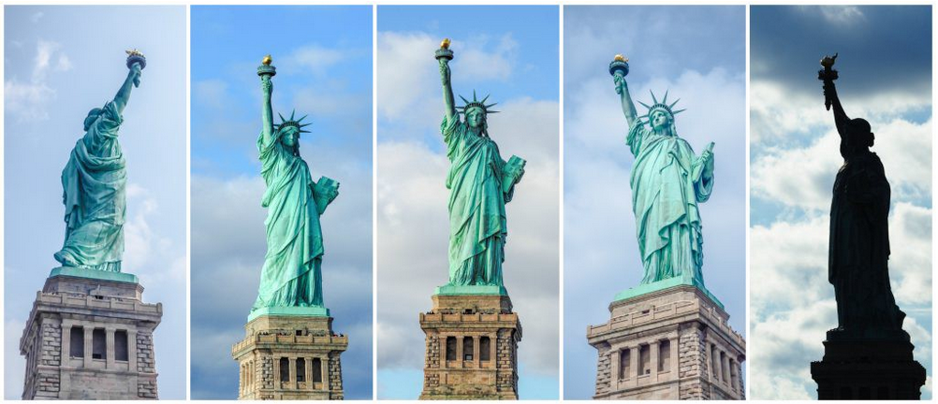
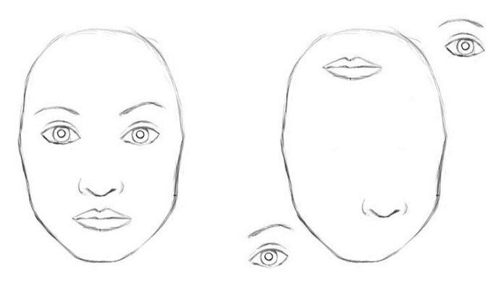
What is the problem?
Traditional CNNs think these pictures are similar; CapNets don't.
Your brain recognizes that these are the same picture; simple CNNs don't.
Provide a survey of CapNets papers by Geoffrey E. Hinton and his research group.
Replaces pooling layer in traditional networks with Capsule hierarchy
Considers relative placement of objects in image
Equivariant with rotation instead of invariant
Demonstrate preliminary results applying capsule networks to XView dataset.
Publicly available dataset containing over one million overhead optical satellite images
Create a CapNets library that would allow researchers to easily use CapNets in their projects.
In Python using Tensorflow with plans to create a PyTorch version afterwards.
Notes:
https://www.kdnuggets.com/2016/11/intuitive-explanation-convolutional-neural-networks.html/3

